Slide 1

Implementation Processes Step by Step

Slide 2
eStandby
Fundamentals
Training
1
Pricing and Offers
What to sell? Maximize Revenue
2
Exposure
- Booking engine
- Nor1 Powered emails
-3rd Party emails
https://docs.google.com/spreadsheets/d/1KBdb-Zd_7oeqlre0Fkvdd5EHg1QSOaVE5lqXg1UnoN8/edit?gid=818305365#gid=818305365
3
Connectivity
Connecting PMS to Nor1
Pricing
Pricing and Offer Configuration
Onsite
Agent Commissions, Onsite Training, Launch Dates

Slide 3
11 Steps
IM Property First Comunication
Property Set Up In CP)
Property Assignment to IM
Data Entry
Sales-Contract
Property Set Up In Salesforce
Property Implementation Call.
Escalation due lack of response
Property Activation
Implementation QA
Property Transition to ARM/ART

Slide 4
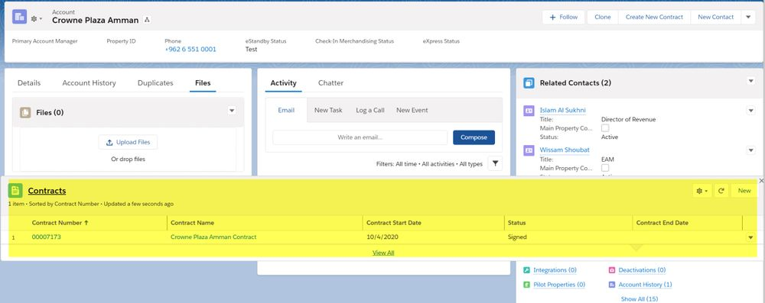
1 Sales - Contract
Following items must be completed by Sales before property gets assigned to IM
Contract and hotel information are uploaded to Salesforce triggering automated notification of entry to Director of Implementations (DOI).
Basic Data Form (BDF)is sent to the hotel by the Contracts Manager

Slide 5
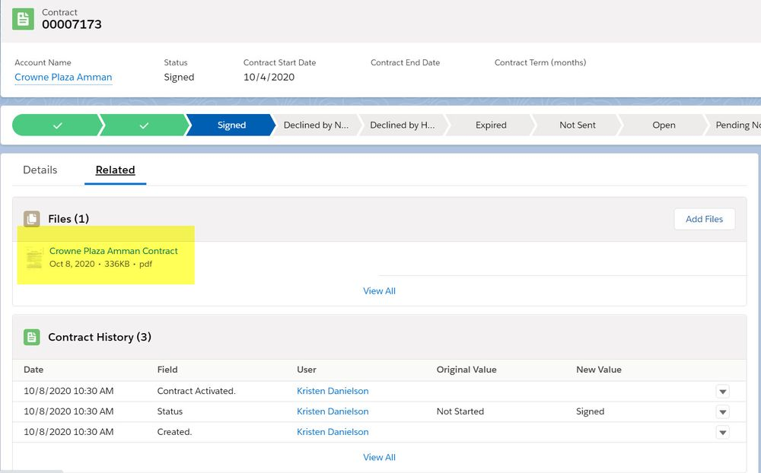
1 Sales - Contract
New Launches Report requires the fields below to be completed to show the new live properties. Fields must be entered in Salesforce by the Contracts Manager

Slide 6
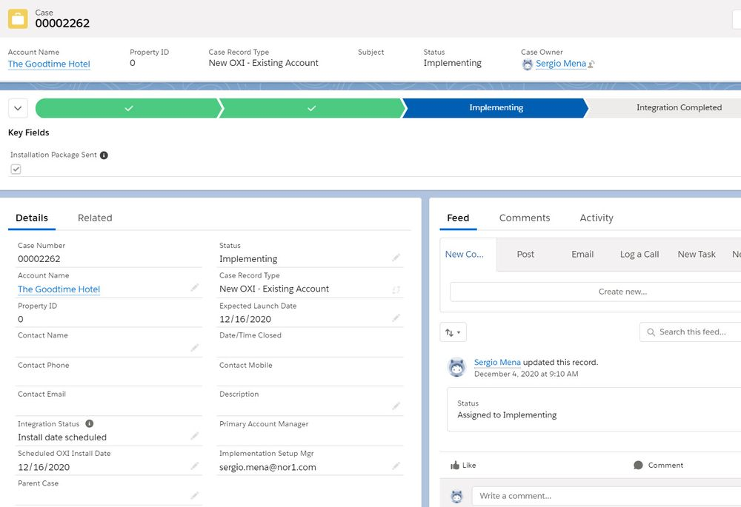
1 Sales - Contract
IMPORTANT:
If the property will be launched with OXI, a Salesforce Case must be created. For any email communications with the customer or Oracle integrations@nor1.com must be copied. ** Please only copy integrations@nor1.com once the Oracle team has provided the customer with an installation date.

Slide 7
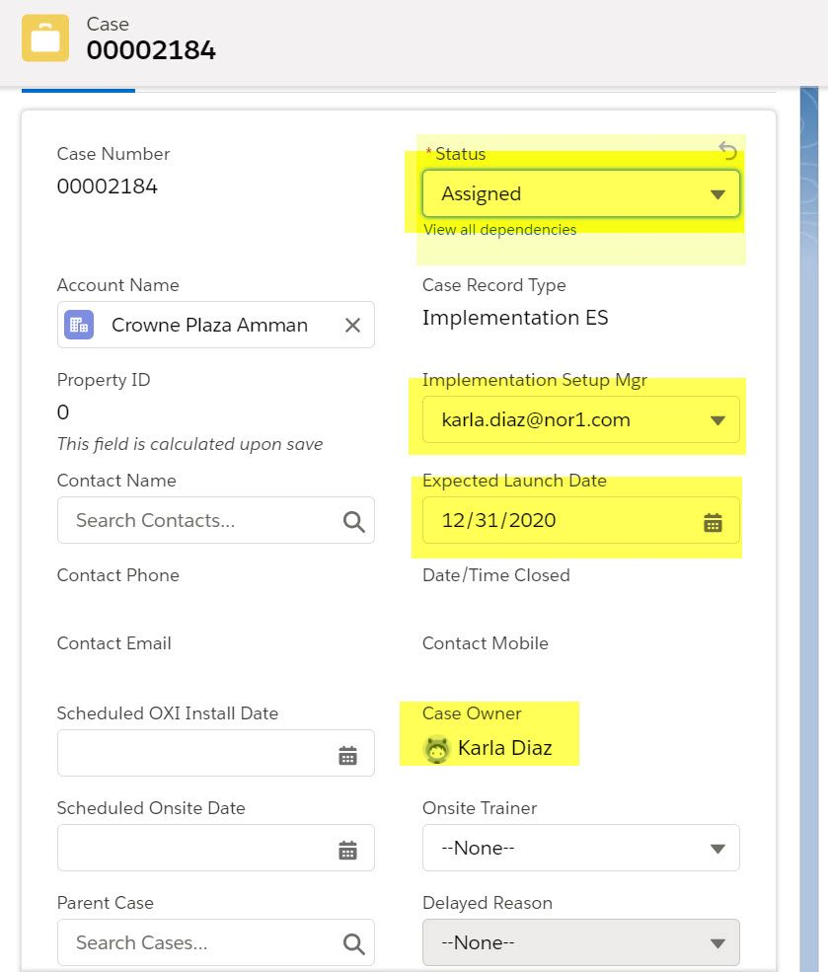
2 Property Assignment to IM - Salesforce Cases
Director of Implementation (DOI) checks hotel details and assigns properties to Implementation Manager (IM)
by revenue priority and Account Revenue Manager (ARM) by geographic location.
The fields below need to be entered by DOI in order to trigger the Implementation email alert for the IM:
Implementation Setup Mgr
Expected Launch Date
Case Owner
Status - Assigned

Slide 8
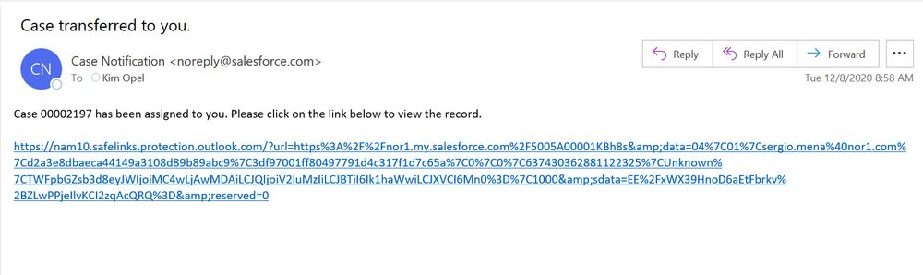
2 Property Assignment to IM - Salesforce Cases
Alert will look like the one below:

Slide 9
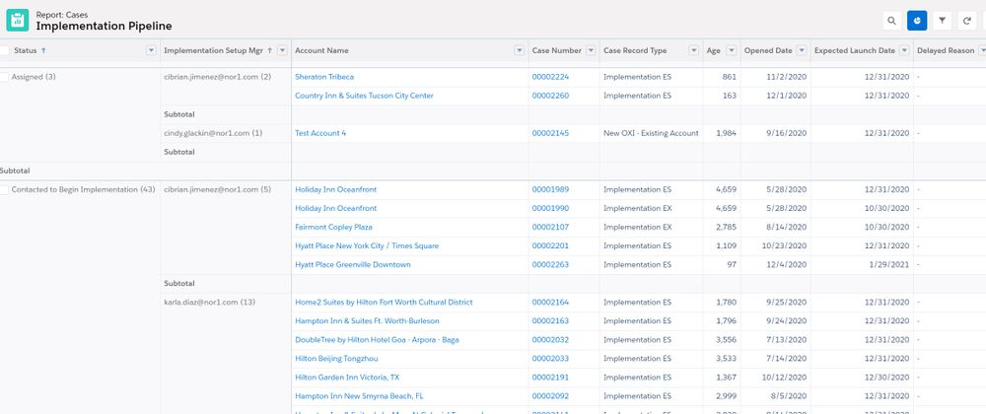
2 Property Assignment to IM - Salesforce Cases
By this moment the property will be now part of the IM pipeline in all salesforce reports.

Slide 10
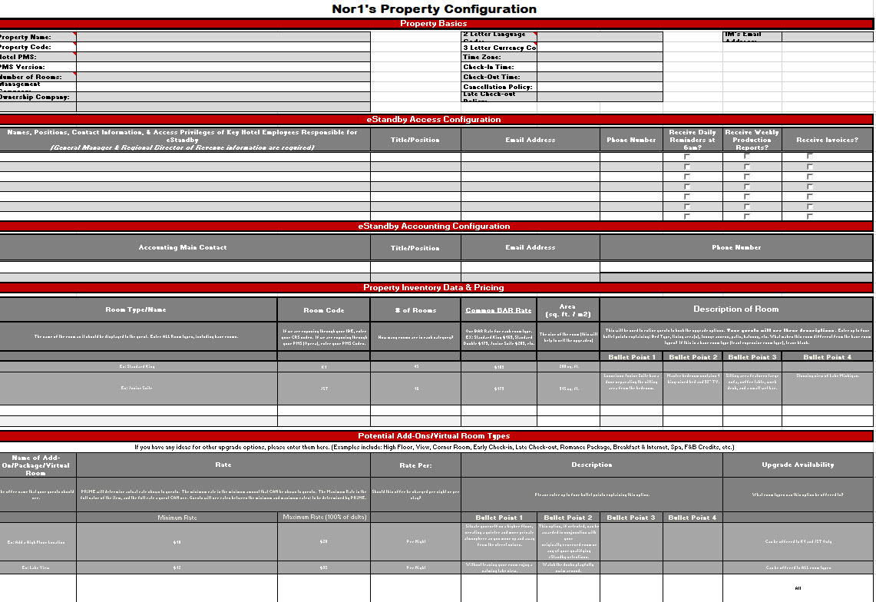
3 IM First communication with the Hotel
Once IM has been assigned to the implementation of a property an introductory email must be sent, we use the contacts given in Saleforce by the Nor1 Sales Manager and Contracts Manager. We have 2 different scenarios…
Property HAS NOT provided BDF:
Property already PROVIDED BDF (CP configuration needs to be done before sending this email)
Whats a BDF?
Online forms.nor1.com/form-2582564/Nor1-EStandby-Im...
Hard Shell

Slide 11
3 IM First communication with the Hotel
Property HAS NOT provided BDF:
From: Sergio Mena
Sent: Tuesday, January 09, 2018 8:35 AM
To: Casey Kokoska; Mark Sampsell
Subject: RE: Embassy Suites Houston West Katy - Let's get your property LIVE on eStandby!
Importance: High
Dear Embassy Suites Houston West Katy Team,
I am very happy to begin working with you to implement your property on Standby. In order to see and complete the initial steps to take your property live on the solution, please go to the link below.
forms.nor1.com/form-2582564/Nor1-EStandby-Im...
Please reach out to me with any questions and complete the information by Thursday January 11th.
I’m looking forward to hearing from you, property information.

Slide 12
3 IM First communication with the Hotel
Property already PROVIDED BDF (CP configuration needs to be done before sending this email)
Dear Mila and Conrad Cartagena Team,
As this is a very quick process, we are almost ready to go live with your property! Please see below what you need to complete/approve in order to go live with eStandby at your hotel
- Please complete the training here: nor1.com/training-new/ It walks you through the benefits of eStandby, what your guests will see, as well as your responsibilities at the hotel to honor your guest upgrade requests in the Upsell Manager.
- Please approve the demo with the photos and descriptions: Click Here (Pricing is only a placeholder and every option is listed even those that won’t be part of the offers).
-Pricing and Offers – We need to setup a webinar to finalize pricing and last details. Please let me know if you are available Wednesday – Friday this week and what time works best so that I can send you a calendar invite, this call should take us maximum 30 minutes.
I’m looking forward to hearing from you and start creating extra revenue through our program, thank you for your partnership!
Kind Regards,

Slide 13
4 Data Entry - DDD (Digital Divide Data)
Once you have received the BDF with all the information you need, DDD can help you with data entry in our systems:
Control Panel
Photos
Descriptions
Pricing
Property General Info
Salesforce
Contacts
Documents
Property General Info
Upsell Manager
- PRIME Controls
New Users
DDD SOP LINK

Slide 14
5 Property Set Up in Control Panel
Property Preferences: Property basic information like name, address, property code, number of rooms, launch date etc…
Room Categories: All the rooms inventory must be added in CP together with room codes, photos, descriptions etc…
Matrices: Pricing matrices for room movement must be added for each property.
Conditions: Valid conditions must be in place in order to grant exposure.
https://cp.estandby.com/categories/display/CHAIN_ID:1196/PROPERTY_ID:9008
*In some cases mostly for SC&I hotels the colors scheme and logo need to be configured as well.

Slide 15
6 Property Set Up in Salesforce
Details: Property basic information like name, address, brand, chain, management company, property code, number of rooms, launch date etc…
Contacts: All the rooms inventory must be added in CP together with room codes, photos, descriptions etc…
https://nor1.lightning.force.com/lightning/r/Account/0015A00002Cz4CHQAZ/view

Slide 16
7 IM-Property Implementation Call
- IM to schedule a pricing/training call with the hotel (30 -45 minutes)
Main Goal: To explain eStandby Upgrade product and finalize the offer set and price points, this should also cover UAC training.
It is crucial for the IM to also secure the go live date with the customer accordingly to whatever is more convenient for them.
UAC training could be scheduled as part of a regularly scheduled brand call, or individually or covered with online training, depending on complexity of property and number of attendees.
IMPORTANT ITEMS TO SECURE DURING THIS CALL:
Ensure that training has been completed or complete training.
Finalize pricing and offer set, get approvals.
Grant a GO Live date and take the hotel live after.
For OXI properties – A live training session must scheduled..

Slide 17
8 Escalations!
-When a property turns unresponsive Implementations will ask for the Sales team assistance. We have a process in place:
2 emails, 2 calls/voicemails with no response in a period of 10 days proceed with escalation to Sales/ Nor1 Chain Manager
Once escalated, you should try one more call and follow up email. If within the next 3 days there is no response from the hotel or from Sales/ Chain Manager. Send the Last attempt email (template below). Make sure to copy the corporate contacts, if you are unsure of who your corporate contact is , please reach out to Sergio Mena.
If no response 2 days after the last attempt email, please notify DOI, so he can close the property.
Last attempt email example:
Dear HOTEL NAME team,
We have been trying to get in contact with you regarding your pending installation of eStandby. As we have not received a response from our previous messages, this will be our final attempt to coordinate with your property on the process. If we do not hear back from you by Friday January 26th, we will be cancelling the installation.
Current outstanding items are:Property information completion and Implementation Requirements (please use the link below)
forms.nor1.com/form-2582564/Nor1-EStandby-Im...
Let us know if you have any questions.
Thank you

Slide 18
9 Property Activation
Property activation must be discussed with the hotel as part of the Implementation call. Once all the implementation steps are completed, property should be set to live in Control Panel and Salesforce.
After pricing and information is approved, hotel is turned live in CP and Sugar
CP:
-Preferences/ Property Status and Launch Date
-Check matrices and conditions ensure offers being sent
Salesforce:
-Property Status
-Launch Date
-The implementation case must also be set to Live.
-Final pricing document and Learn More Image must be uploaded

Slide 19
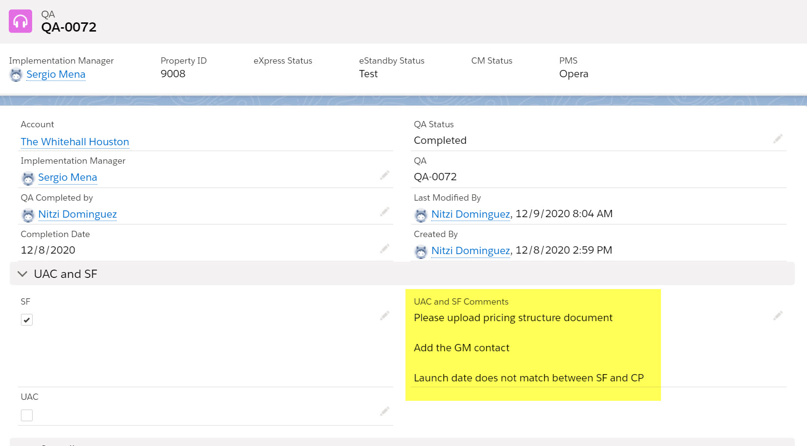
10 Implementation QA
In order to ensure Quality Assurance every single property is QA’d by the support team.
Given the complexity and the amount of information loaded in different systems mistakes may occur.
The process is very structured and have very clear guidelines. There is a list of specific items that are checked.
A Salesforce case is created, and the Implementation Manager is notified about the issues and items to be fixed, could be something as simple as a wrong room code, missing pictures, missing contacts or more complex stuff like no exposure.
https://nor1.lightning.force.com/lightning/r/QA__c/a0J5A00000U5Qt9UAF/view

Slide 20

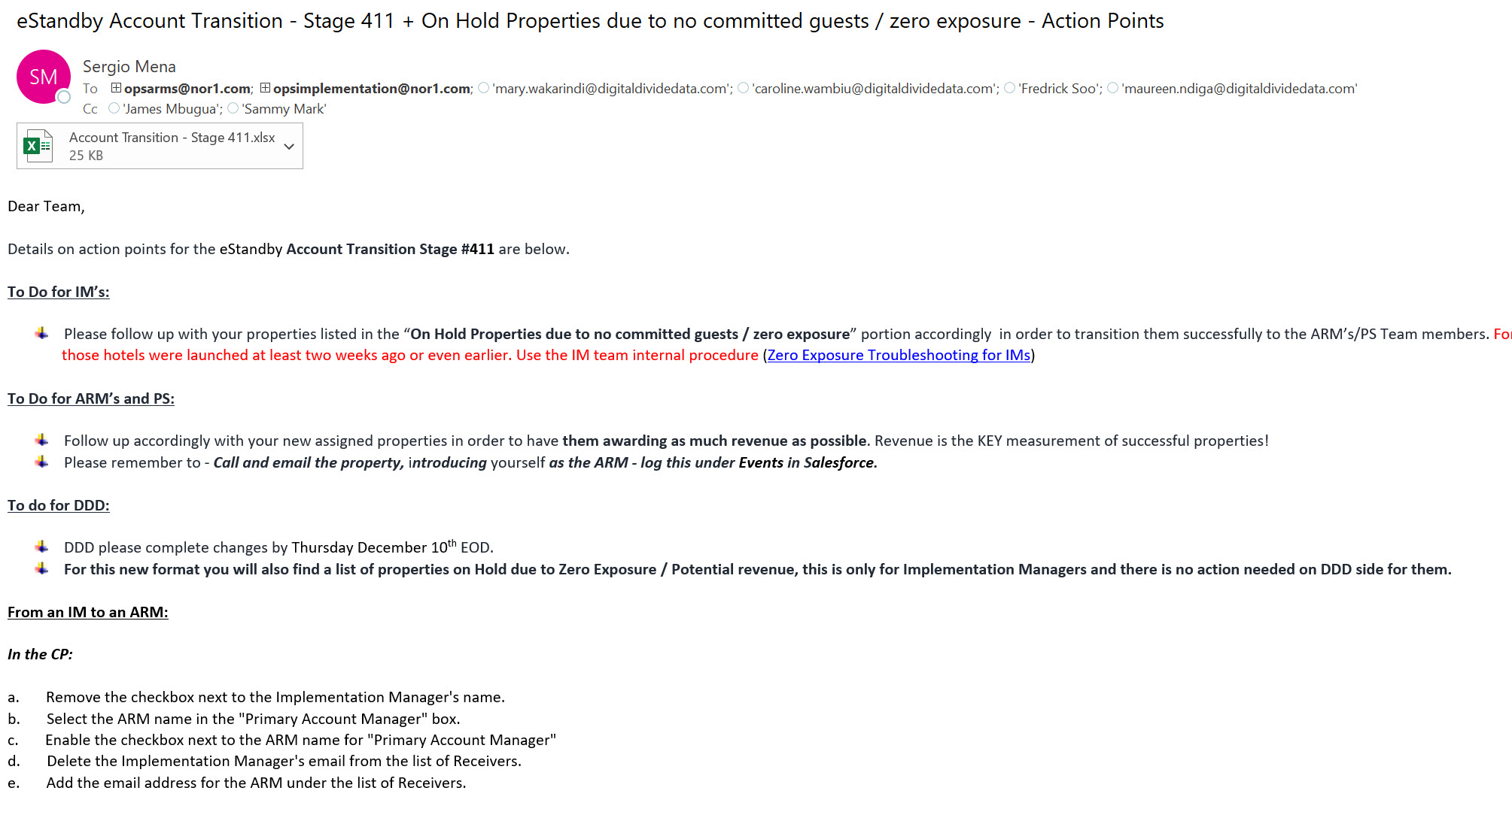
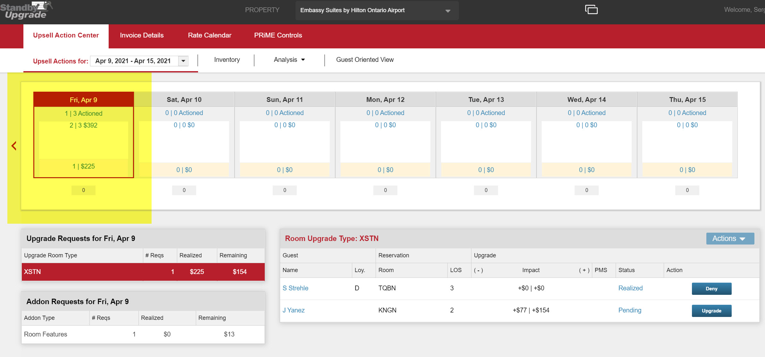
11 Property Transition to ARM/ART
Every Thursday the DOI will send the Transition Report.
In order to be transitioned a property must have potential revenue in the Upsell Manager. Being live is not enough! Account Transition - Stage 427.xlsx

Slide 21
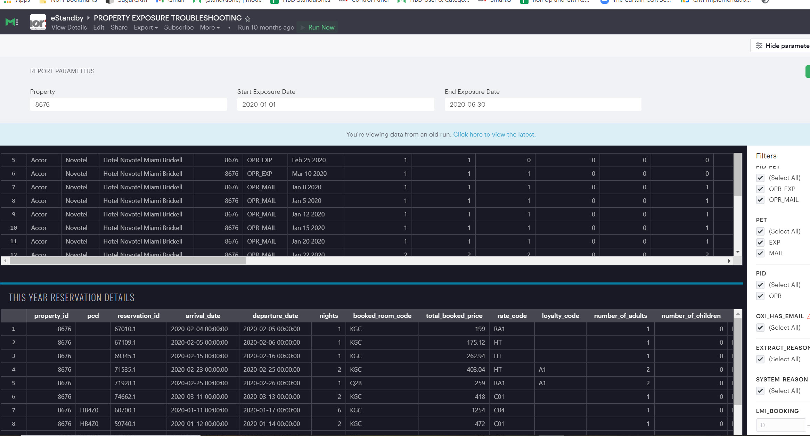
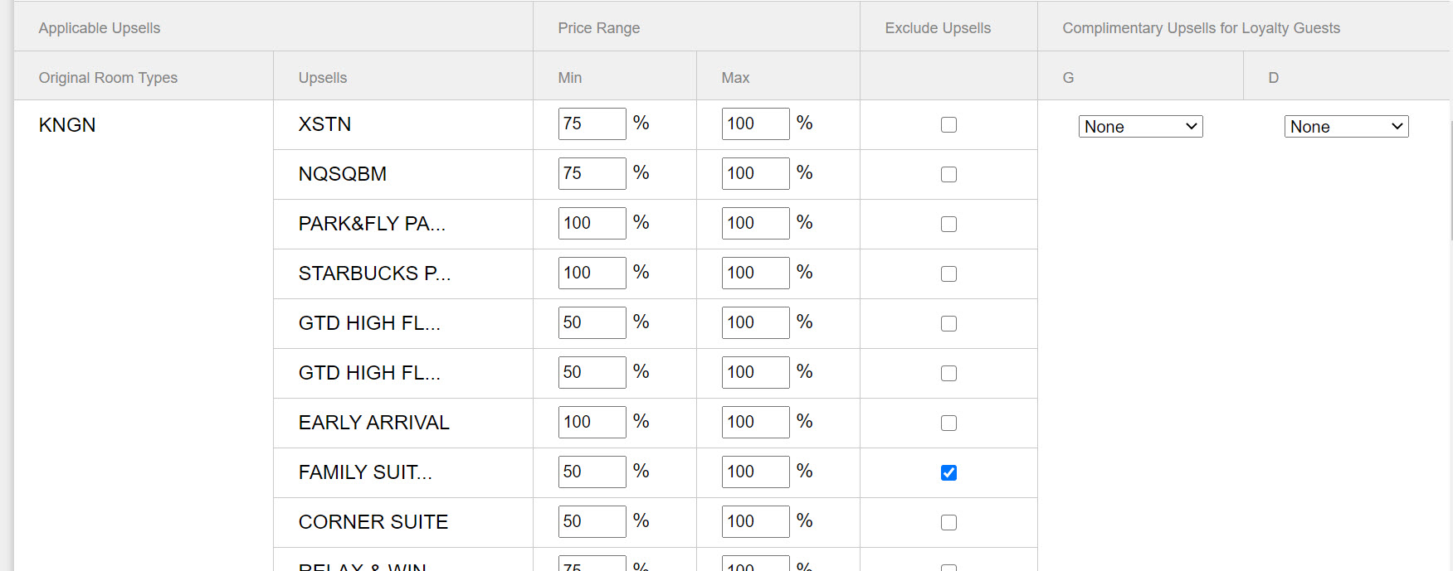
11 Property Transition to ARM/ART – Exposure Troubleshooting – Offer Set Review
Not transitioned Properties SOP!!!
*No exposure (Errors in setup, tech issues, low traffic)
*Offer Set not Optimized (Poor set of offers, percentages)

Slide 22
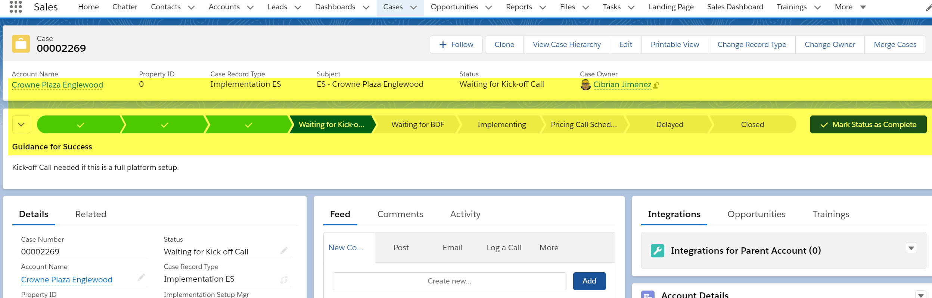
*All stages are tracked in SF with checkboxes for key fields
https://nor1.lightning.force.com/lightning/r/Case/5005A00001Mbe3kQAB/view

Slide 23
eXpress
Fundamentals
Training
1
Pricing and Offers
What to sell? Maximize Revenue!
2
Exposure
Only for OXI properties
3
Connectivity
Connecting PMS to Nor1
Pricing
Pricing and Offer Configuration
Onsite
Agent Commissions, Onsite Training, Launch Dates

Slide 24
What do we need from the hotel?
Pricing Structure: A different version of PRIME is used. Need to discuss the percentages to be used with the hotel as we do for eStandby.
The Knickerbocker - eXpress Pricing Structure.xlsx
* The default price range is 50% – 100%, if different price points are needed then a ticket must be open for IT.
Email offers: Will be sent 24, 48 or 72 hours prior the day of arrival. Subject to each property and chain, needs to be discussed with the hotel. Best conversion proven is 48 hours!!
Transaction Code: A opera transaction code needs to be secured from the hotel. It can only be shared with eStandby.
Billing: Clarify that we are using the same invoice with differentiated information by program (applies for eStandby and eXpress)

Slide 25
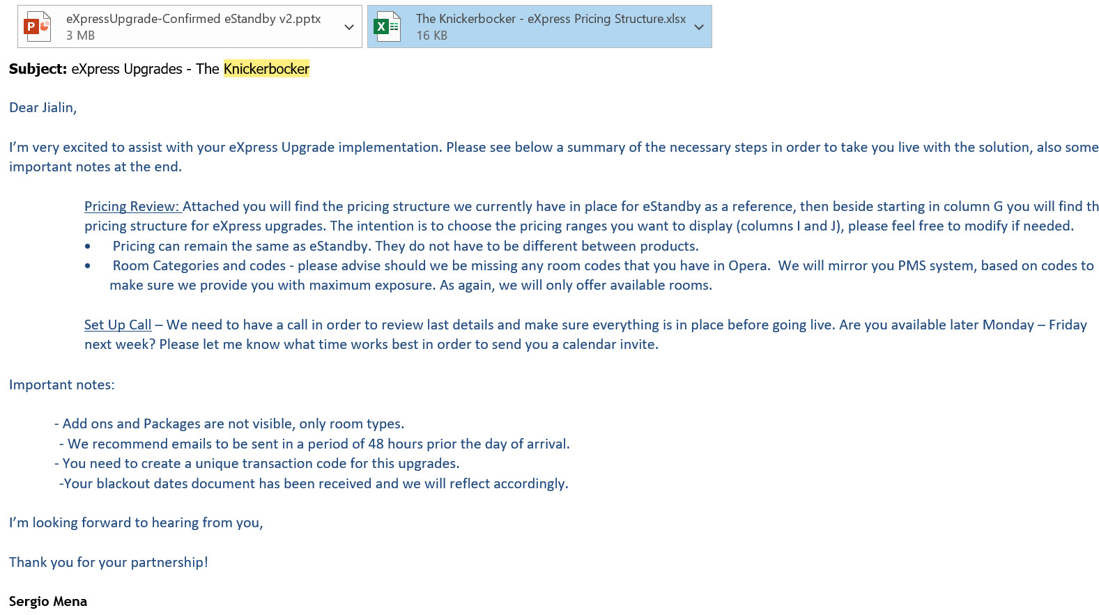
What do we need from the hotel?

Slide 26
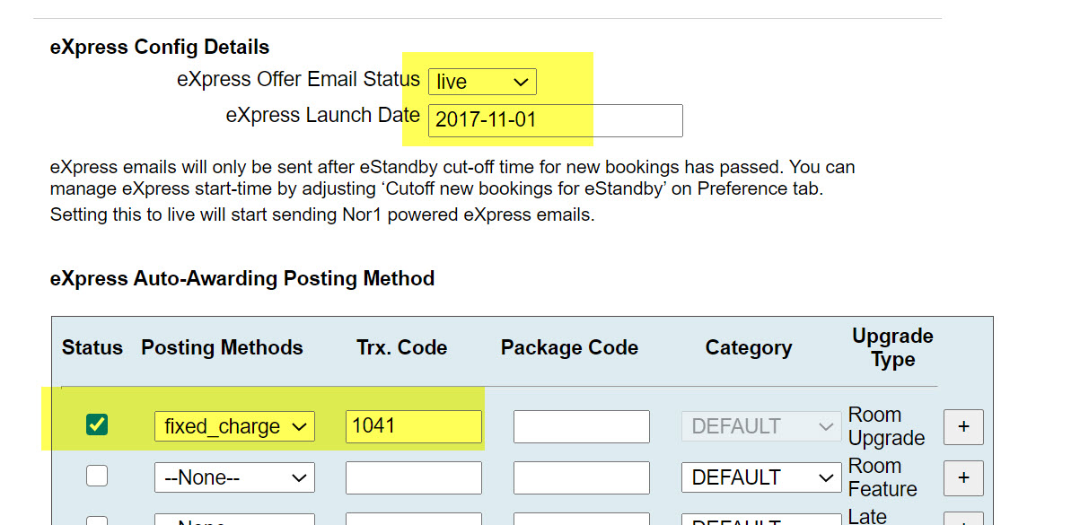
Configuration – Control Panel
Go to the Integrations Tab in Control Panel
Set the eXpress Offer Email Status to Live
Add the Launch Date
*Emails will be sent only after the cut off time for new booking has passed, make sure you check that on the “Preferences” tab
Go to the eXpress Auto-Awarding Posting Method and do the following:
Status check box: checked
Posting method: fixed charge
Trx. Code: unique transaction code provided by the property
Type: Room Upgrade

Slide 27
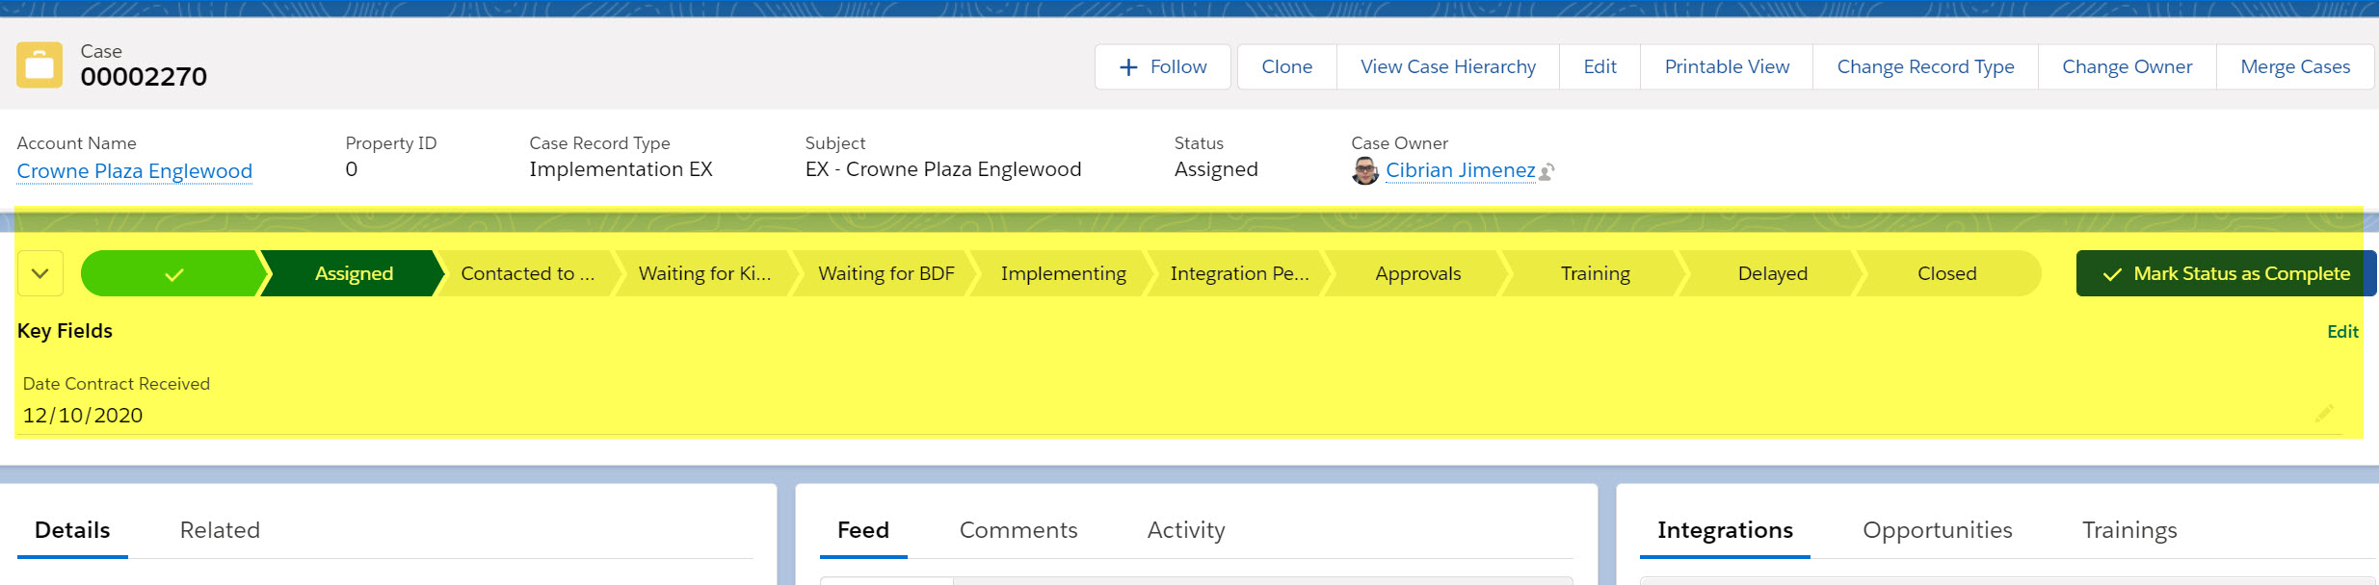
*All stages are tracked in SF with checkboxes for key fields
https://nor1.lightning.force.com/lightning/r/Case/5005A00001Mbe3lQAB/view

Slide 28
CheckIn Merchandising
Fundamentals
Training
Getting us to next steps
1
Pricing and Offers
What to sell? Maximize Revenue
2
Connectivity
Foundational Importance
3
Connectivity
Connecting PMS to Nor1
Pricing
Pricing and Offer Configuration
Onsite
Agent Commissions, Onsite Training, Launch Dates

Slide 29
12 Steps
Control Panel Integration
Offers & Add ons Set Up
Assignment
Kick off Call
Integration OXI / OSRs
Salesforce
Property CM Activation
Testing Call
Pre Onsite Call
Onsite
Verification Onsite
Post Implementation

Slide 30
1 New CM Implementation Assignment
Once contract is signed by Sales Department, Director of Implementation will be notified and proceed to assign to appropriate Implementation Manager (IM) and Account Manager (ARM). Slightly different to eStandby
Expectations and recommendations can be advised during this process for IM. As for ARM, Director of Account Management for EMEA/APAC and AMERICAS will be advised when new contracts is signed, to advise who the potential ARM will be. Each CM Implementation, needs an assigned ARM, as well as an IM.
Implementation Setup Mgr
Expected Launch Date
Case Owner
Status - Assigned

Slide 31
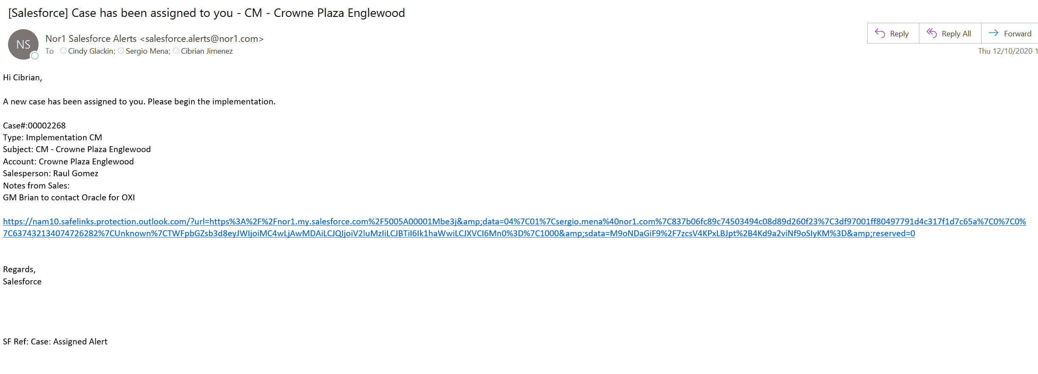
1 New CM Implementation Assignment
Alert for the IM will look like the one below:

Slide 32
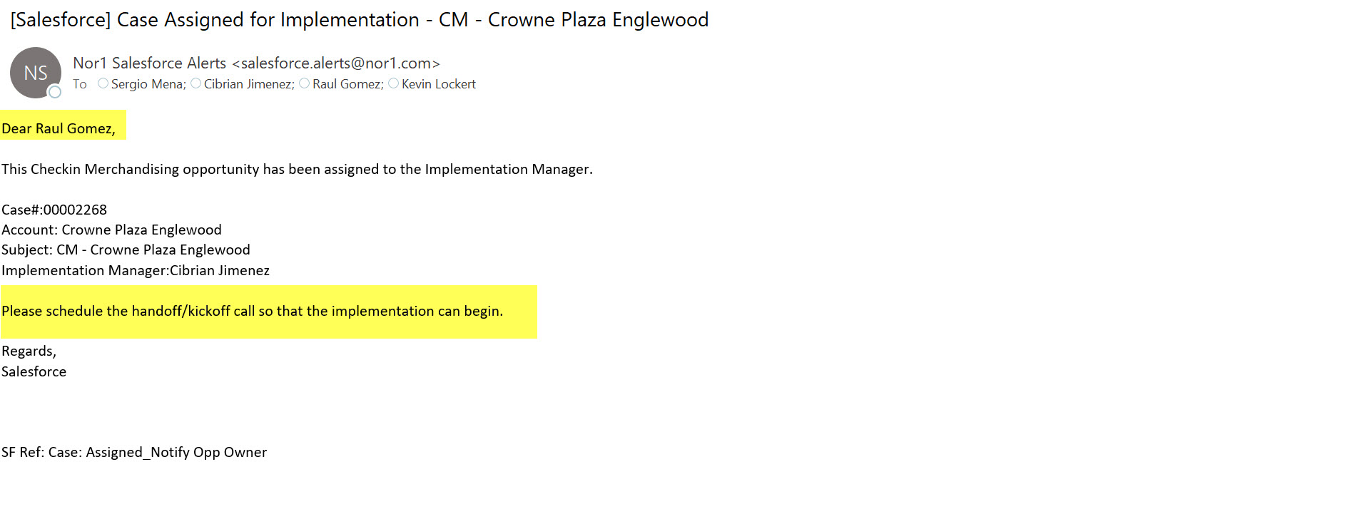
1 New CM Implementation Assignment
KOC alert Sales is copied and they are the ones to schedule:

Slide 33
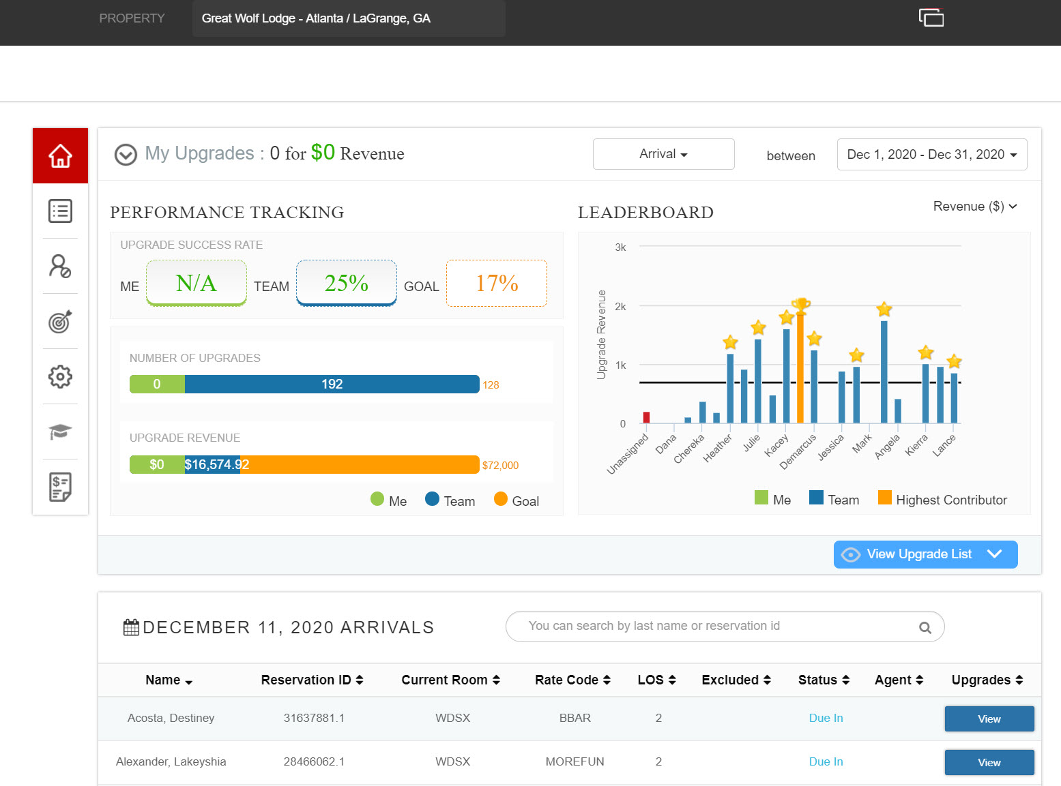
2 Kick off Call
Salesperson will arrange the first call with the Revenue Manager and Front Office Manager and IM (14 Days prior launch). IM to introduce himself to the property and introduction about CM
KOC Presentation
OXI Integration
Transaction Codes
Opera Simple Reports
Basic Data Form
Live Demo so that they know why the requirements!

Slide 34
From Scratch** Data Entry - DDD (Digital Divide Data)
Once you have received the BDF with all the information you need, DDD can help you with data entry in our systems:
Control Panel
Photos
Descriptions
Pricing
Property General Info
Salesforce
Contacts
Documents
Property General Info
Upsell Manager
- PRIME Controls
New Users
DDD SOP LINK

Slide 35
From Scratch** Property Set Up in Control Panel
Property Preferences: Property basic information like name, address, property code, number of rooms, launch date etc…
Room Categories: All the rooms inventory must be added in CP together with room codes, photos, descriptions etc…
Matrices: Pricing matrices for room movement must be added for each property.
Conditions: Valid conditions must be in place in order to grant exposure.
https://cp.estandby.com/categories/display/CHAIN_ID:1196/PROPERTY_ID:9008
*In some cases mostly for SC&I hotels the colors scheme and logo need to be configured as well.

Slide 36
From Scratch** Property Set Up in Salesforce
Details: Property basic information like name, address, brand, chain, management company, property code, number of rooms, launch date etc…
Contacts: All the rooms inventory must be added in CP together with room codes, photos, descriptions etc…
https://nor1.lightning.force.com/lightning/r/Account/0015A00002Cz4CHQAZ/view

Slide 37
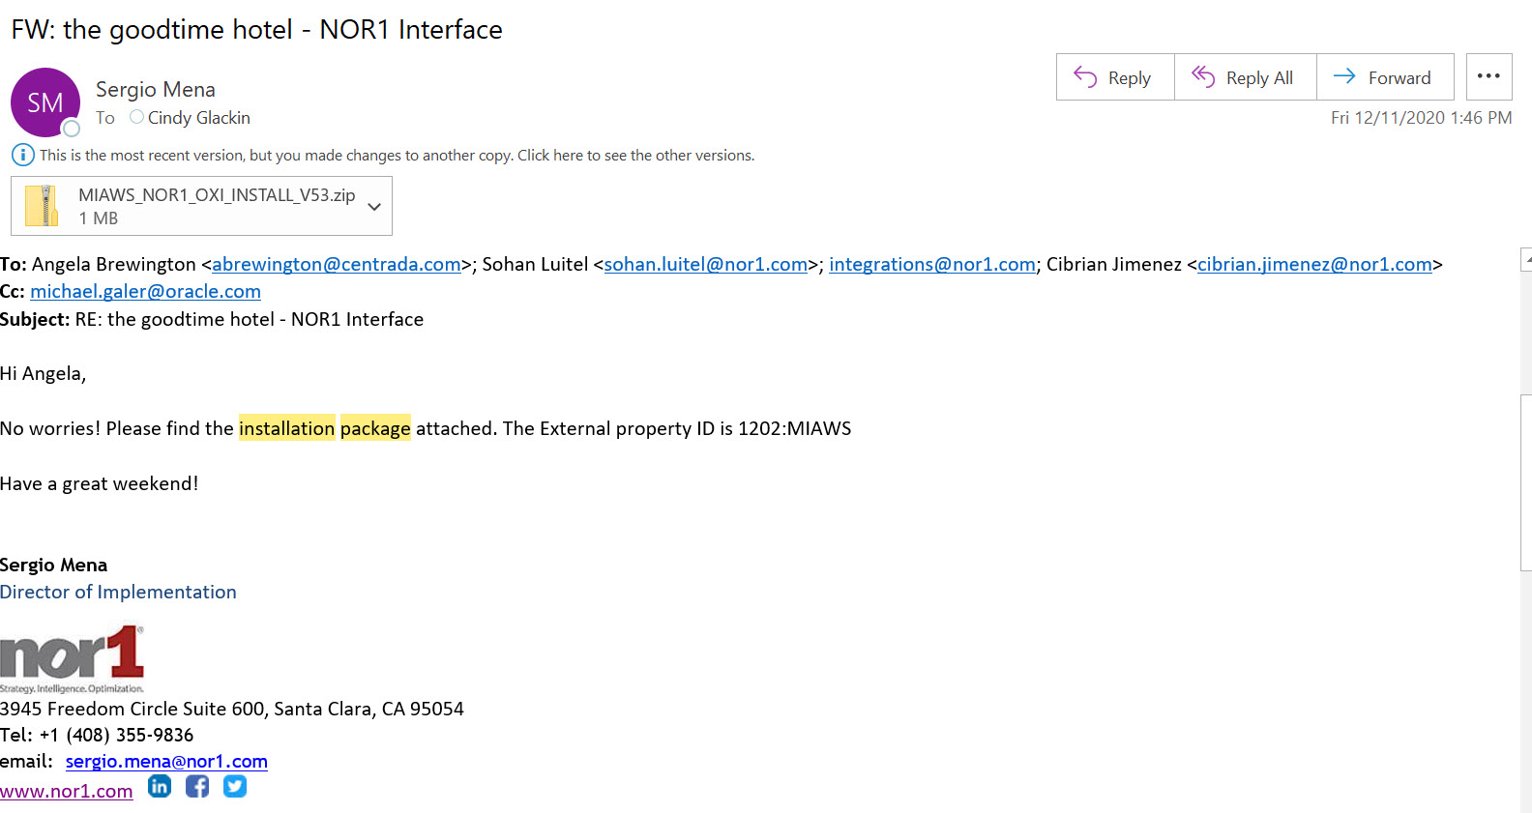
3 Integration OXI Installation – First Contact
Once the hotel is in touch with Oracle and has an installation date the NOr1 team at integrations@nor1.com is looped in.
Installation Package is sent together with the External Property ID

Slide 38
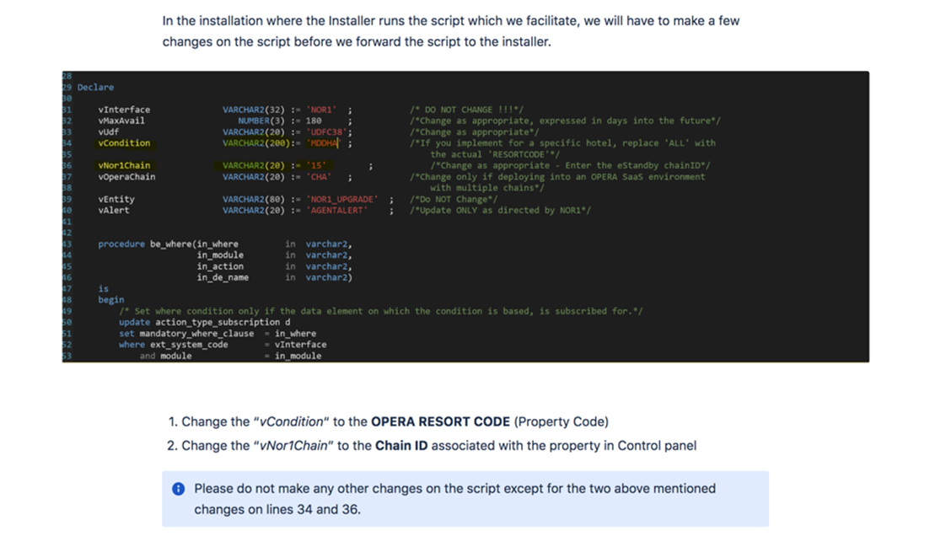
3 Integration OXI Installation – What do we send?
External Property ID is made from the following : Nor1 Chain ID:Opera Resort Code
example The Goodtime Hotel 1202:MIAWS
We need to make some adjustments to the script before sending it!!!

Slide 39
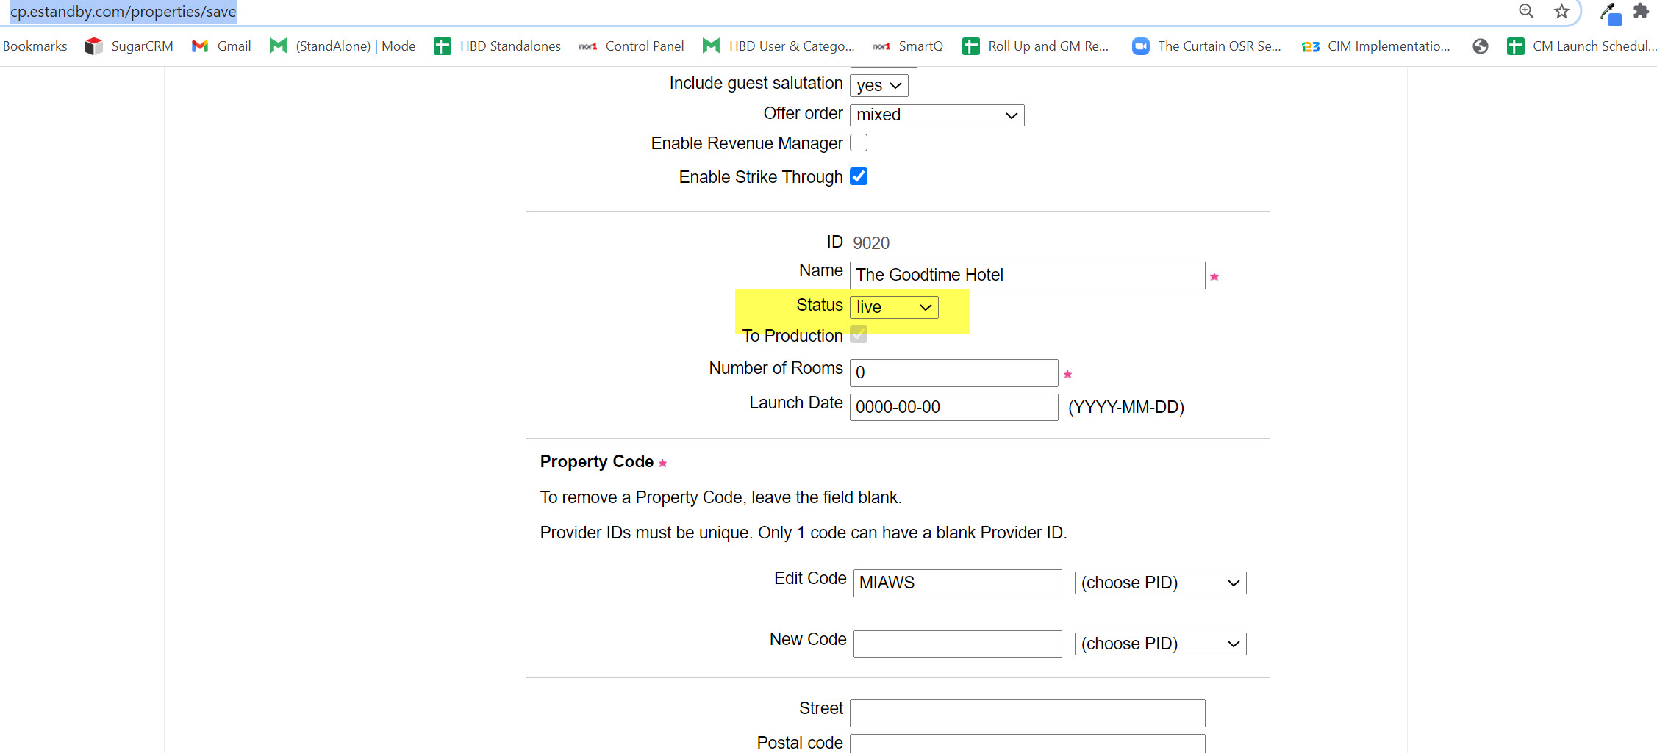
3 Integration OXI Installation – Control Panel
It is crucial that the hotel is set to live before the installation!!! As a consequence, the chain and hotel must have been previously created in Control Panel

Slide 40
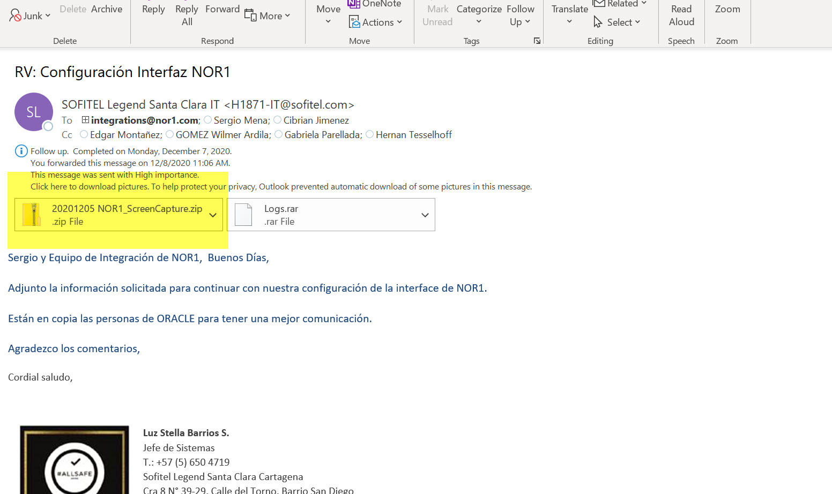
3 Integration OXI Installation – Installation Day!!
Oracle reaches out confirming that the OXI has been installed and provides the requested screenshots in the package.

Slide 41
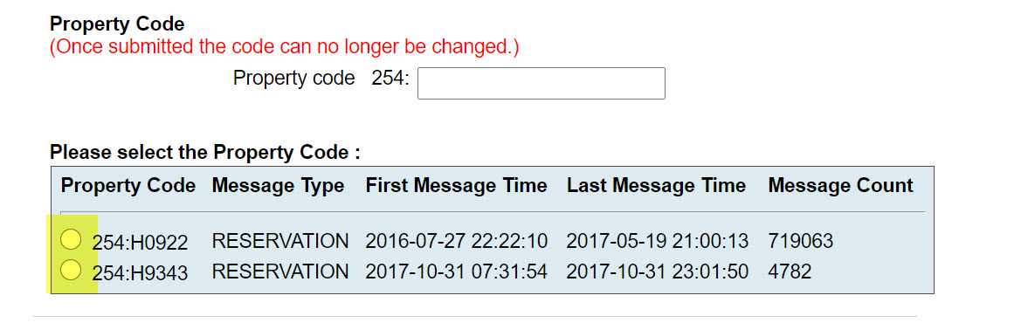
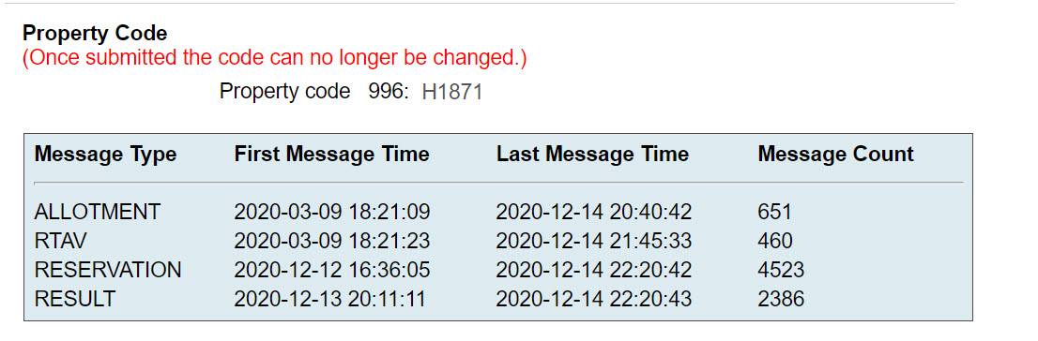
3 Integration OXI Installation – Control Panel
Then Nor1 goes to CP and activates the interface in order to make sure that messages are flowing successfully.
Activation: Select the right property, be careful!!!
Messages flowing:

Slide 42
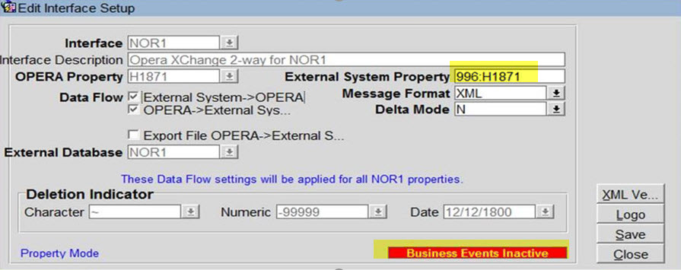
3 Integration OXI Installation – Control Panel
Once that you are able to see messages it mean that the OXI installation has been successful!
In very few cases we are not able to see messages then some troubleshooting is needed.
Initially we usually ask the Oracle installer to re process messages, this is a classic one!
Also in the screenshots provided we need to make sure that all the setting are correct, one common mistake could be that the installer added an incorrect External Property Code or Business Events are inactive for example.

Slide 43
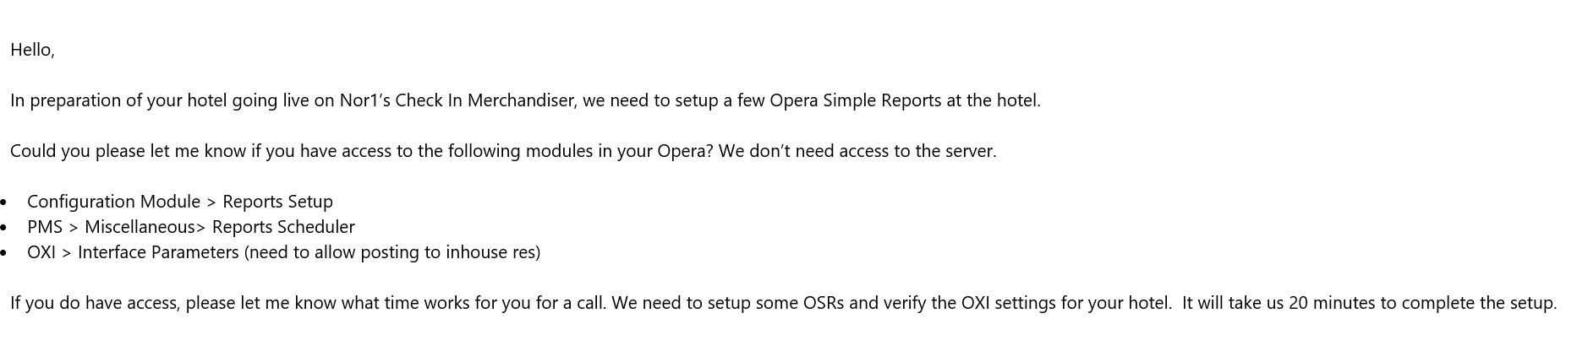
3 Integration (OSRs) Call
IM should schedule a call with property Program Manager: 10 days prior to launch a call must be held to review the following:
- Review Set up / Pending Items (Transaction Codes for example)
Create and Schedule OSRs
5 AM OSR Transaction Report
10 PM OSR Transaction Report
how to setup Recovery OSR Transaction Report
It is important to make sure that the person to speak with has the necessary credentials in Opera in oder to give us access to the OSRs creation. If not they must invite the right user.

Slide 44
4 Control Panel Integration
Integrations Tab
https://cp.estandby.com/properties/integration_edit/6926
Config Name: Opera Integration:
CM Status:
-None: Has never been turned on or implemented
-Live: OSRs, Transaction Codes have been tested and everything is working OK. Property is ready to be live (All other fields were filled out). 1click clear is activated from CM App when status changes to test.
-Test: Property is not ready to be live, but allows you to add transaction codes and to do testing
-Inactive: CM was once inactive and then turned off.
Launch Date: This field dictates the date from when we will start processing all the reservations data. Its important that this field is entered as soon you have tested the transaction codes and the property is ready to start using CM.
Property Code as found in extract files: Data sync depends of this field, if the code is incorrect, we will not be able to know to what property the data belongs.
Property's extract email address: This is the email from OSRs (Opera Simple Reports) are sent to us,
Enable PMS Transaction Data Sync: must be checked, this fields is what triggers the transactions data sync

Slide 45
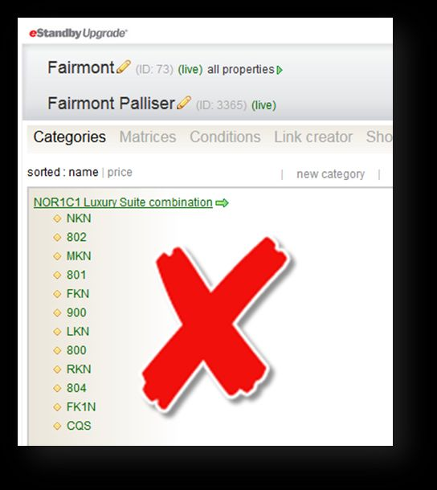
5 Offers- Rooms, Add-ons & Custom Upgrade Set Up
Room Categories: Each room category must have one room code only. Verify that there are not duplicated category names or codes and that categories and rooms have the right status. Double check price per for all rooms and add-ons to make sure its correct.
No Combo Rooms: Due Opera OXI Integration all rooms in CP must exist in their Opera system

Slide 46
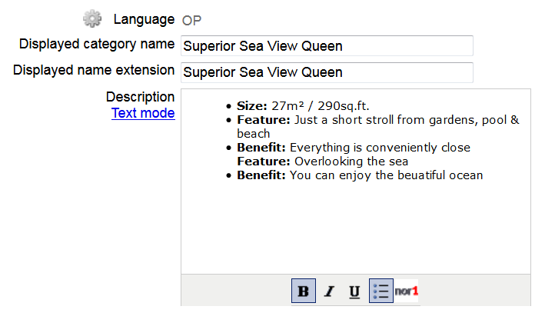
5 Offers- Rooms, Add-ons & Custom Upgrade Set Up
OP Language: This is the text that agents will see.
All upgrade room categories must have a complete description. Please complete each Description box using the following format:Size
Feature
Benefit

Slide 47
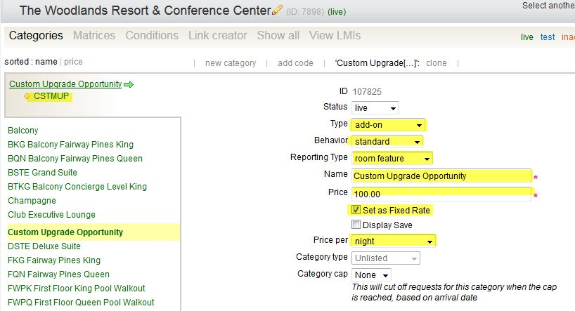
5 Offers- Rooms, Add-ons & Custom Upgrade Set Up
Custom Upgrade: For Reservations greater than 7 nights, for room features & views not available as add-ons, to substitute for a blocked room and for in-stay reservations not reflecting current availability.
**Special constrain is required- see further below
Note: (check if it applies to the chain and brand)
Create a new category in Control Panel and name it "Custom Upgrade Opportunity"
Price: $100 (just a place holder, agent will be able to modify)
Price Per: Must be per night
Code: CSTMUP
Picture: Hotel’s Logo
Description: This item to be used only when recommending upgrades that are not listed. Please ensure to provide an upgrade price and a comment with upgraded room type.

Slide 48
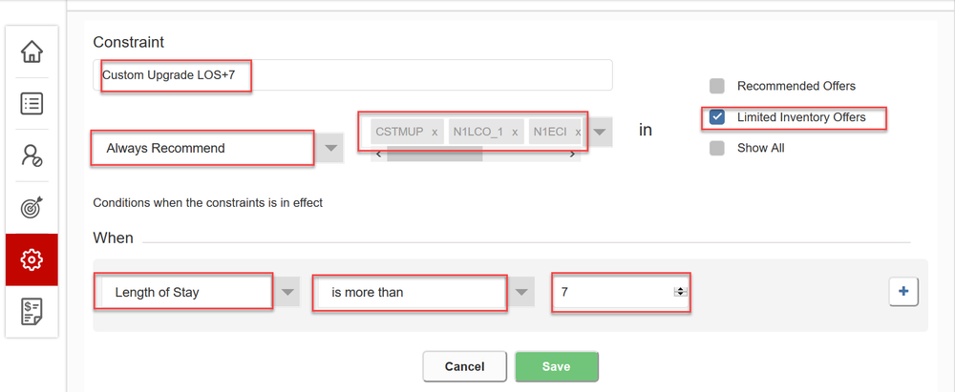
5 Offers- Rooms, Add-ons & Custom Upgrade Set Up
Add ons:Set up is as usual for eStandby, besides making sure OP language has no bullet points in description.
7 + length of stay reservations- 7+ LOS reservations will show no inventory availability (= no offers). To make sure that the agents still can upgrade, create a constrain that includes Custom Upgrade opportunity (check if it applies to the chain and brand) and add-ons, set up as limited offer set, example below:

Slide 49
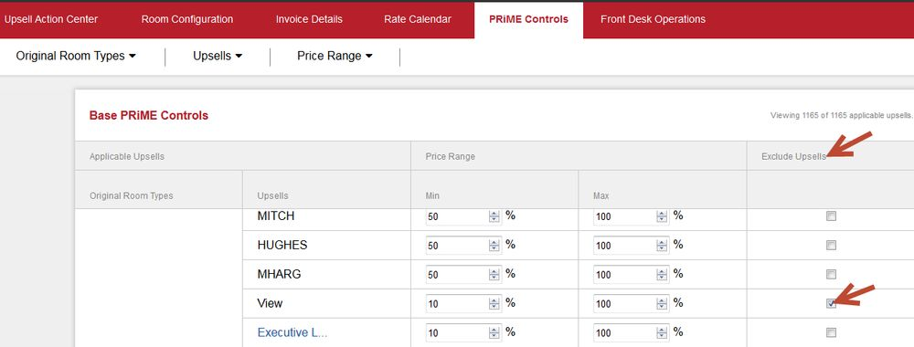
5 Offers- Rooms, Add-ons & Custom Upgrade Set Up
eStandby Exclusions
Any new offer created in CP will automatically be sent to PRiME in the Nor1 portal. Its important that If certain addon upgrades are not supposed to be offered for eStandby, you exclude them from eStandby by clicking on the exclude button
*Any other special requirements per chain must be adjusted for example rate code exclusions.

Slide 50
6 Salesforce
UPDATE INDIVIDUAL PROPERTY DETAILS
Go to Property Salesforce Account, scroll down to “Nor1 Operations” and find “CheckIn Merchandising”Column. IM’s responsibility is to keep the statistics updated during launch.
Details for specific properties will include:Nor1 Product - Check-In Merchandising
Select one of the following, depending on the status of your CM launch.
Test - to be used when property is being implemented.
Live - to be used when property is live.
Inactive – to be used when property, after going live, decides to inactivate.
Cancelled – to be used when property, during implementation – test mode, decides to cancel and not proceed with the implementation.
Blank – neither of the above. No action was taken for this property yet.
CM Launch Date: Select the LIVE date, once property is live. If not live, area remains blank.
CM Implementation Manager: Implementation Manager assignment, handled by Director of Implementation.
**Upload de BDF and update the PM**
https://nor1.lightning.force.com/lightning/r/Account/0015A00002GM5aWQAT/view

Slide 51
6 Salesforce
ON THE CASE UPDATE THE FOLLOWING:
CM Expected Launch Date: Launch Expectation enter for tracking purposes. IM is responsible to keeping this updated. If changes need to occur, IM is responsible to advise Director of Implementation, Account Manager and Sales Contact.
CM Scheduled Onsite Date: Onsite Training Expectation enter for tracking purposes.
CM OXI Install date: must be filled out under the Implementation tab
Once Implementation is completed Checklists must be uploaded in Salesforce Case record
CM Implementation Pre Onsite Checklist
CM Implementation On Site and Post Implementation Checklist

Slide 52
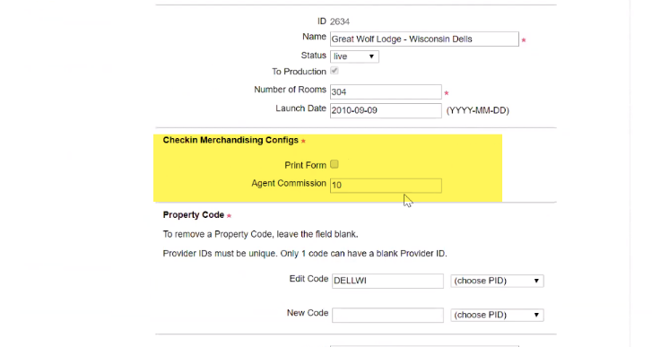
7 Property CM Activation
Property Distribution List: Distribution list for the Program Manager and General Manager report. All changes on this sheet will automatically update the back end table every day at 12:30AM UTC (4:30PM PST), same as the control panel refresh time, therefore, no need to submit the ticket for pm & gm report distribution list change. Link: Engineering CM Launch Details
CP Property ID: This field is mandatory to be able to send GM report
Roll up Report: Distribution list for the Roll out report send to corporate. Link: Engineering CM Launch Details
Commissions Set Up: Go to CP/ Property Preferences, enter the commission requested by the property. Default is 10 (%) field only needs to be updated if the commission is different than 10. Commission field allows you to add up to 2 decimal points. No commission? Leave the field blank
Print Form: To activate the print form functionality in CM, box must be checked
**Notes:
Data will be shown in CM after production push
Distribution lists MUST be entered before the launch date in the Integration Tab
Click submit at the bottom of the page to save the changes

Slide 53
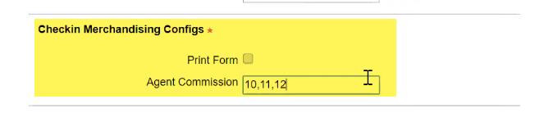
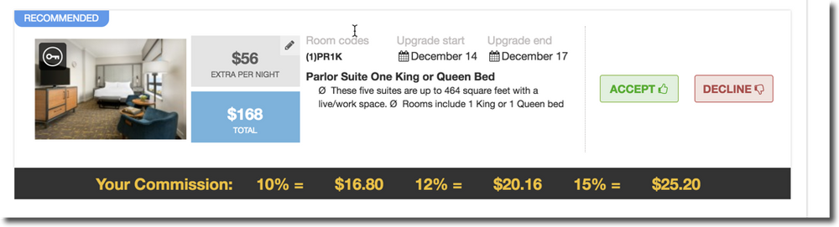
7 Property CM Activation
For tiered commissions, separate the using commas (,) keep in mind that the first one you enter is the one that will be shown in the exported report.
Tiered commissions is to display different commission tiers under each offer in CM App. On the Downloaded Incentive report, We can’t calculate Incentives for multiple tiered commission. The commission that will be shown in the report is the one that you entered first, example above: 10%
Enter the Goals on the CM application
Monthly goals must be uploaded on the CM app
For more details, check this link: Activate Property on CM-Control Panel
VPN is required

Slide 54
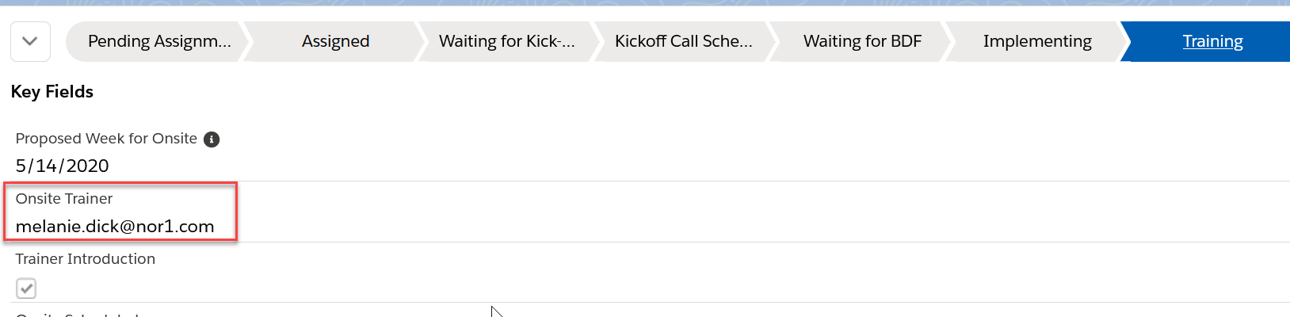
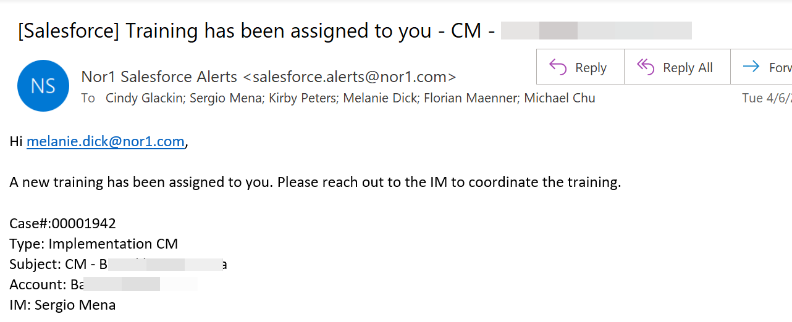
7 Trainer Assignment
The Implementation Manager will reach out to the Training Manager to request a trainer assignment.
The Training Manager will go into the Salesforce case and assign a Trainer. Salesforce notifies the Trainer and IM and ARM.

Slide 55
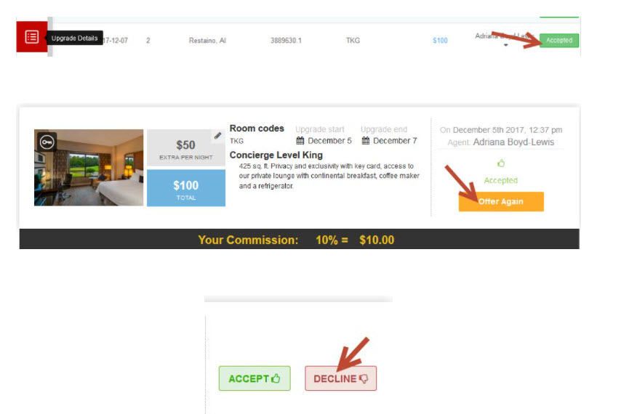
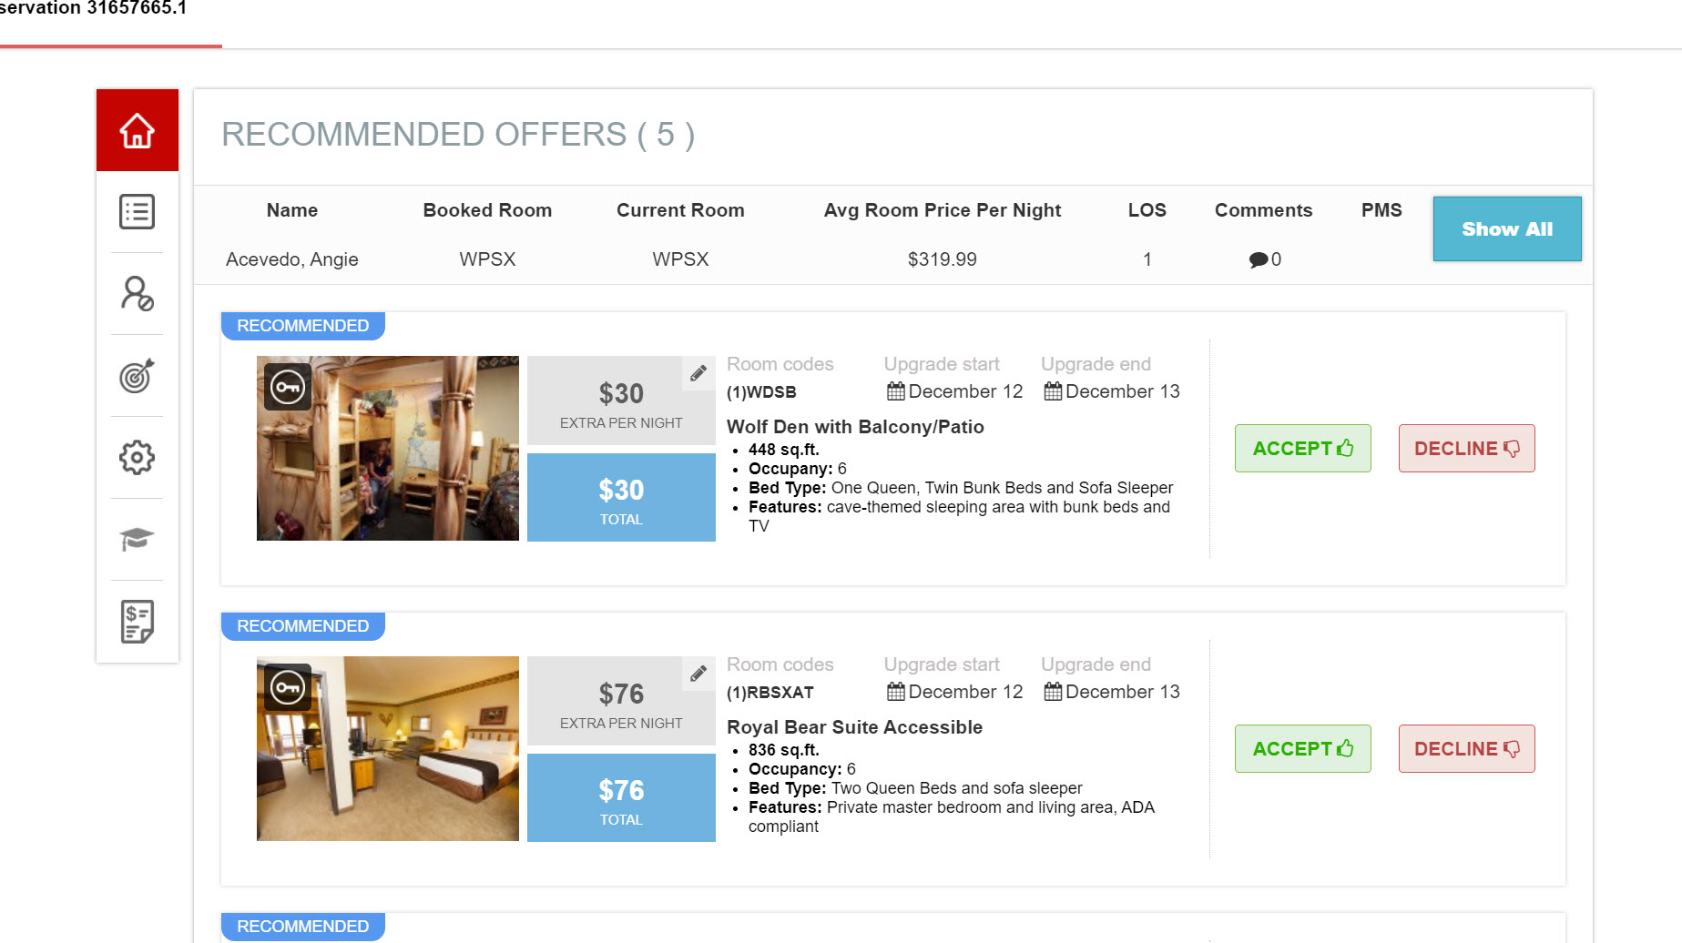
8 Testing Call
IM must schedule 10-15 minutes zoom call with the PM in order to review the following:
Confirm that fixed charges are posting/removing in Opera - Uses the app in real time and hits “accepted” for inhouse and due in reservations. *One post per transaction code is recommended.
Make sure that the rooms inventory is accurate
Review the offer set in general making sure that there are no odd offers or mistakes and everything is displaying normally.
*In case that fixed charges are not posting then troubleshooting is required.
https://sites.google.com/nor1.com/newhiretraining/oxi-faq#h.p__kl_JobGC6Ny
CM Pre Onsite List is Required and must be filled out as well- CM Implementation Pre Onsite Checklist

Slide 56
9 Pre Onsite Call – Trainer*
Schedule your Pre-onsite Call (1 week prior to launch), required attendees are: Revenue Manager & Front Office Leadership
-Obtain attendee list for each training
-Confirm Executive Leadership Meeting (GM, Director of Finance, Revenue Manager, FOM, Program Manager)
-Confirm Program Manager (liaison between Nor1 and Hotel)
-Confirm Program Manager meeting on day of arrival
-Request front desk check-in standards - to be utilized during training
-Confirm any additional exclusions
-Confirm Go Live Date (after first training or final training)
-Send Post Launch Report to Hotel - review criteria used to determine whether hotel is set up to be successful
Prepare
-Review your presentations
-Print and bring copies of presentations/checklists/agendas
Training materials
OXI 2 Way Integration external training materials

Slide 57
10 Onsite – Trainer*
AT PROPERTY ARRIVAL
Front Desk Terminal(s) - Application Link: If the hotel has not already loaded the desktop link/Icon verify the website on the front desk PCs (If the hotel has loaded the link ensure you can successfully login - May need to work with property on whitelisting Nor1 IP Address). *Desktop link is part of the attachments in step 2 of this document.
Meeting Day of Arrival
Verify any last-minute business rules - Program Manager
Verify if meeting room is ready with all requirements (view checklist)
Executive Leadership Meeting, review your ppt presentation
Verify Matrix (Blockings) for the next 7-10 days: You should check the availability for the next days. If the hotels pre-blocks everything to balance their inventory, there are virtually almost no upgrade opportunities, so ideally they should block as little as possible.
Designate an area in the back office for “Check in Merchandiser Recognition Board”. Whiteboard brought by Nor1
CM Users: Create and or update the property users to have CM access, right before each training session. If possible, have them to login righ after the training using your computer, that way you ensure that they have access and can start using CM inmediately. How to create or update CM users IMPORTANT: CM users shouldnt have access to GOV, please make sure to remove it one by one from Old Admin User

Slide 58
10 Onsite – Trainer*
Day 1
Meetings and Materials:
Executive Leadership Meeting:
The Art of CheckIn Merchandising Executive Team
Hotel Commitment to Success
The Art of CheckIn Merchandising - Front Desk Agent Workshop
The Art of CheckIn Merchandising Agent Manual
Team Member Committment
The Art of CheckIn Merchandising Front Desk Team (presentation must be personalized with logo and property name)
Application Training: Live training of CM portal
The Art of Leadership Front Desk Managers
The Art of Leadership Front Desk Managers
CM Hotel Implementation Worksheet
Program Manager Reference Guide -Program Manager
Hotel Implementation Worksheet - Review with Program Manager what is completed and what is missing
Quick introduction to Intercom Help Center and Chat

Slide 59
10 Onsite – Trainer*
Day 2
The Art of CheckIn Merchandising - Front Desk Agent Workshop
Day 3
The Art of CheckIn Merchandising - Front Desk Agent Workshop
*Other important tasks:
Program Manager Responsibilities - Post Launch Report
Review Post Launch responsabilities with Program Manager using the Program Manager Reference Guide
Schedule and agree on weekly progress call
Property Tour

Slide 60
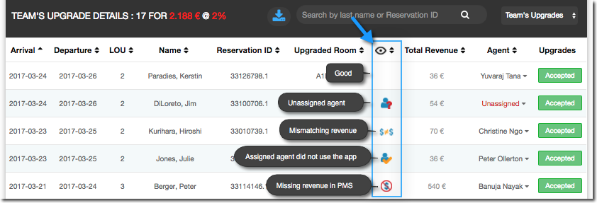
11 Verification Onsite -Trainer*
Post OXI Configuration Verification
Verify each awarded transaction from previous day(s). Do this each day while on property. Posted CM transactions should be posting in Opera. If something is not working make sur that the correct transaction code are in:
a) OSR
b) CP
c) CM Activation Form
d) Check 'Traces' on the reservation for error message. *You will not have access to the Opera billing screen, have the Program Manager assist.
Error Verification: Review Error notifications and troubleshoot to get them fixed
https://docs.google.com/document/d/1ffVkK2SHL-ZO1s2AHEraP8CcjTZ22uj_jHv0_5aAgEI/edit#heading=h.5s1koc7czsdb

Slide 61
12 Post Implementation*
Post Implementation on Property
Shadow agents / assist with logins / engage staff / attend front office preshifts
Distribute Engagement Guide / share best practices /provide kickoff engagement “gift cards”
Confirm weekly follow-up call with Program Manager / Confirm Monthly recurring call
Wrap up Meeting with hotel where Post Launch Survey is Reviewed with Property and areas of improvement noted
Post Implementation
Send Thank You follow up to all agents who attended training - Dave Hallman to assist
Collect new Opera descriptions from property and update control panel
Send Post launch Survey to Corporate Contact two weeks after Launch once hotel has corrected areas of improvement
Intercom maintenance: Routing to ARM and ARM Manager (or at least two people for ensuring coverage)
Response time of 2 hours on average (response does not equal resolution)
Tag each conversation, and close each chat with the specific saved response that Cindy created
Advise program manager about new conversation for each issue

Slide 62
12 Post Implementation*
Weekly for Weeks 1-5 -15 Minute Performance and Engagement Call
(FOM, Program Manager, Nor1 Implementation Manager)
Review of performance
Answer questions
Make sure that goals are entered for at least a year
Refer to Checkpoint Call SOP for materials and mandatory requirementes
Monthly (After 5th week)
(DR, FOM, Program Manager, Nor1 Implementation Manager)
Review of performance
Variation to goals
Quarterly
Additional classroom training, as needed
Shadowing & Coaching front desk agents
Program Manager support

Slide 63
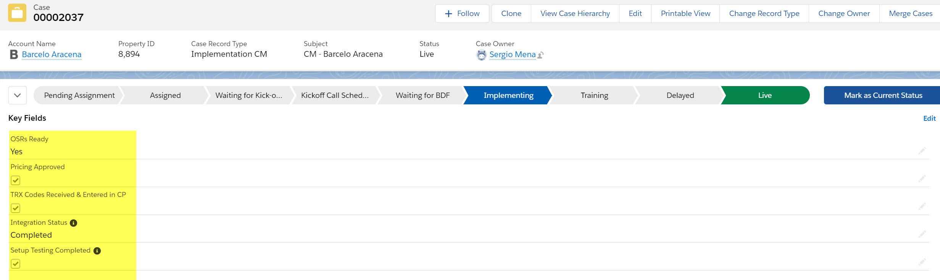
*All stages are tracked in SF with checkboxes for key fields
https://nor1.lightning.force.com/lightning/r/Case/5005A00001HfiqoQAB/view

Slide 64


Slide 65
Forward Looking Statement
Statements in this presentation relating to Oracle’s future plans, expectations, beliefs, intentions, and prospects are “forward-looking statements” and are subject to material risks and uncertainties. A detailed discussion of these factors and other risks that affect our business is contained in Oracle’s Securities and Exchange Commission (SEC) filings, including our most recent reports on Form 10-K and Form 10-Q under the heading “Risk Factors.” These filings are available on the SEC’s website or on Oracle’s website at http://www.oracle.com/investor. All information in this presentation is current as of INSERT MONTH HERE 2020 and Oracle undertakes no duty to update any statement in light of new information or future events.

